Slide 1

DSB
Demand
Strategy
Builder
Workshop 2: Recap
INSTRUCTIONS FOR USING THIS PRESENTATION - delete before presenting
This presentation can be used to remind workshop participants in Workshop 2:
What the DSB is
The DSB process
WORKSHOP 2 | Workshop 2 Recap Introduction Session
ROSA version 2.0
Photo: DFID

Slide 2
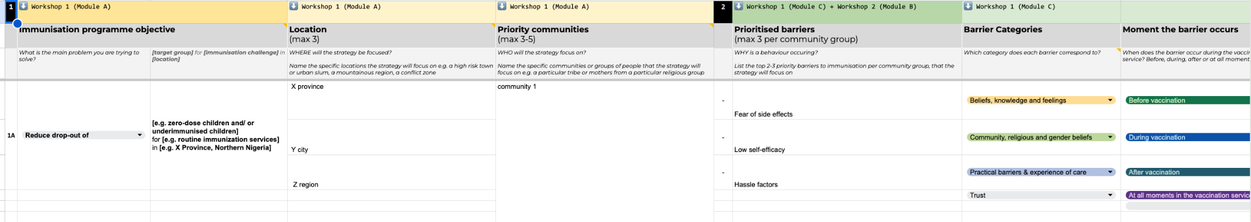
What is the Demand Strategy Builder?
The DSB is a process that we will go through together to identify the reasons for low immunization rates, and in response, develop solutions to increase immunization demand. By the end of the DSB process, we will have an immunization demand strategy that is:
Focused
Evidence-based
Human-centred
Solutions-focused
Localised
Ready to be implemented
The DSB will guide you through a process to build out your strategy, step-by-step.
WHAT IS THE DSB?

Slide 3

Where are we now?
INSTRUCTIONS
You will explain the DSB process and remind participants where in the process we currently are
You will do a brief recap of the completed activities so far

Slide 4
The DSB Process
INSTRUCTIONS - delete before presenting
Briefly describe the steps that you have already covered, and indicate where you currently are in the process (arrow)
The DSB is a five-step process. Everyone in the room will be involved in three steps: Workshop 1, Field Research, and Workshop 2. At the end of the process, we will have an immunization demand strategy targeted at the highest risk zero-dose or underimmunized communities.
We are here
STEP | INITIAL INSIGHTS (2-3 days) | WORKSHOP 1 (2 days) | FIELD RESEARCH (1-2 days) | WORKSHOP 2 (3 days) | FINALISATION (Half day)
Description | Core team analyses data and plans the budget, timeline, and logistics for the DSB process. | Two-day workshop to define priority locations, communities, and reasons communities aren’t vaccinating. Day 1: Module A: Validate Module B: Who Module C: Why Day 2: Module D: Her first Module E: Field plan | One- to two-day field trip to collect qualitative data, build empathy, and explore immunization barriers. | Three-day workshop to analyse fieldwork, develop solutions, and create an implementation plan. Module A: Adjust Who Module B: Adjust Why Module C: Solve Module D: Implement | Key decision makers will finalise the demand strategy for implementation.

Slide 5
Recap of Workshop 1
INSTRUCTIONS - delete before presenting
Fill in the details of the priority communities identified in Workshop 1. Note which of the 3 priority locations each community is located.
If you have less than five priority communities, delete the lines that aren’t applicable.
Priority Locations and Communities
WHERE and WHO will the strategy focus on?
Priority Communities (up to five) | Which of the three priority locations is each community found in?
1)
2)
3)
4)
5)
RECAP OF WORKSHOP 1

Slide 6
Recap of Workshop 1
INSTRUCTIONS - delete before presenting
For EACH prioritised community, fill in one line to describe each barrier identified.
Copy the slide for the number of priority communities you identified in Workshop 1, so each community group has one slide.
Priority Barriers
WHAT barriers will the strategy try to solve for each community/ group?
Community 1 Name:
  Barrier 1:
  Barrier 2:
  Barrier 3:
RECAP OF WORKSHOP 1

Slide 7
Recap of Workshop 1
INSTRUCTIONS - delete before presenting
If you identified any health system barriers to solve on the Health System Barriers Poster at the end of Workshop 1: Module C, add them here.
If not, delete this slide.
Health System Barriers
Are there any health system barriers you want to solve?
Barrier 1:
Barrier 2:
Barrier 3:
RECAP OF WORKSHOP 1

Slide 8
Thank you!

