Slide 1

DSB
Demand
Strategy
Builder
Introduction to the DSB for Workshop Participants
INSTRUCTIONS FOR USING THIS PRESENTATION - delete before presenting
This presentation can be used to introduce workshop participants in Workshop 1:
What the DSB is
The DSB process
Insert presentation
details here
WORKSHOP 1 | Workshop introduction session
ROSA version 2.0

Slide 2
Agenda
Welcome & Introductions
What is the DSB?
Questions & Next Steps
INSTRUCTIONS FOR USING THIS PRESENTATION - delete before presenting
It is recommended that the agenda for the kickoff includes these 4 items.
But in your context, there may be information you need to cover that is not included.
Add agenda items and timings.

Slide 3

What is the Demand Strategy Builder (DSB)?
INSTRUCTIONS - delete before presenting
Introduce workshop participants to the DSB, including what it is, its value and benefits, and the final outcome.
You will explain the DSB process and what tools will be used.

Slide 4
We’re here to understand…
?
?
?
?
?
Which locations have the lowest immunization coverage and communities who have never been immunized (zero-dose)?
What are the reasons for people not vaccinating?
How can we develop solutions focused on the high-risk groups or zero-dose children (ZDC)?
How can we develop solutions that go beyond raising awareness & communication?
How can we create a plan for how to implement these solutions?
We want to answer these questions, and develop a strategy or plan to increase demand for immunization in the communities with lowest vaccination rates.

Slide 5
What is an Immunization Demand Strategy?
Immunization demand is people’s willingness to seek out, accept and use vaccines. It is impacted by factors like:
Trust in the healthcare system
Belief in vaccine safety and benefits
Practical issues like ability to access healthcare due to a lack of infrastructure or high cost
And many more…
An Immunization Demand Strategy is a plan to increase vaccination rates, focused on the key reasons communities aren’t vaccinating. It outlines clear solutions and actions to increase immunization demand.
WHAT IS THE DSB?

Slide 6
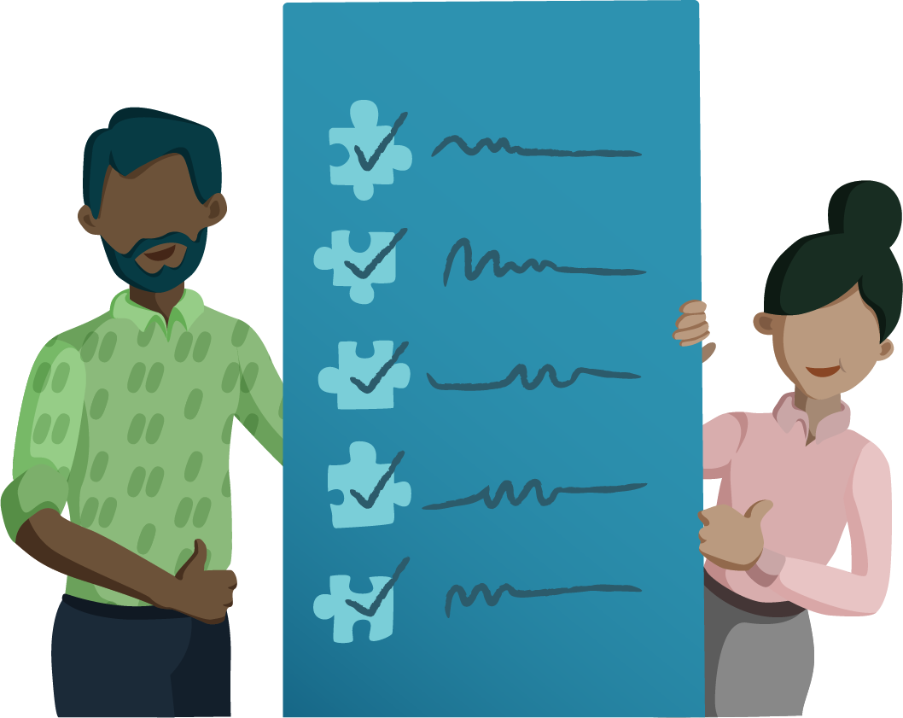
What is the Demand Strategy Builder?
It's a process that we will go through together to identify the reasons for low immunization rates and develop solutions to increase immunization demand.
Get ready to…
Find new solutions to generate demand for immunization
Better understand caregivers and healthcare workers
Reduce vaccine inequalities
Develop a plan to help you go quickly from strategy to action
This will be a collaborative and creative process!
WHAT IS THE DSB?

Slide 7
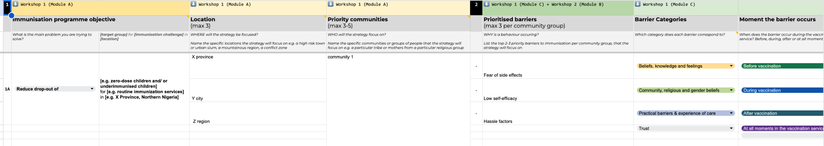
What will you walk away with?
By the end of the DSB process, you should have a demand strategy that is:
Focused
Evidence-based
Human-centred
Solutions-focused
Localised
The DSB will guide you through a process to build out your strategy, step-by-step.
WHAT IS THE DSB?

Slide 8
What will this look like?
THE STRATEGY TEMPLATE WILL INCLUDE THESE COMPONENTS
Throughout the DSB process, you’ll work together to complete:
Your Immunization Programme Objective: The main objective of your immunization demand strategy.
Priority Locations: The areas and regions that your strategy will target.
Priority Communities: The key groups your strategy will support.
Barriers to Immunization: An overview of the key challenges that prevent caregivers from vaccinating their children.
Solutions: Simple and actionable steps to address these challenges.
Implementation Plan:
  Timeline: When each step will take place.
  Budget: The estimated cost for each solution.
  Funding sources: Where the money will come from to fund your solutions.
  Implementers: The people or groups responsible for the work.
  Indicators: Measures to track progress and success.
WHAT IS THE DSB?

Slide 9
The DSB
Process
INSTRUCTIONS - delete before presenting
In this section, briefly introduce the DSB process
Elaborate on some activities we will cover in each step of the process.

Slide 10
The DSB Process
INSTRUCTIONS - delete before presenting
Start by explaining the overall DSB process and its key moments.
Let participants know the average time it takes to complete the process from start to finish.
Explain that Initial Insights is a planning phase, that has already happened.
Change the time taken for each step if you need more or less time.
The DSB is a five-step process. Everyone in the room will be involved in three steps: Workshop 1, Field Research, and Workshop 2. At the end of the process, we will have an Immunization Demand Strategy targeted at the highest risk zero-dose or underimmunized communities.
We are here
STEP | INITIAL INSIGHTS (2-3 days) | WORKSHOP 1 (2 days) | FIELD RESEARCH (1-2 days) | WORKSHOP 2 (3 days) | FINALISATION (Half day)
Description | Core team analyses data and plans the budget, timeline, and logistics for the DSB process. | Two-day workshop to define priority locations, communities, and reasons communities aren’t vaccinating. Day 1: Module A: Validate Module B: Who Module C: Why Day 2: Module D: Her First Module E: Field Plan | One- to two-day field trip to collect qualitative data, build empathy, and explore immunization barriers. | Three-day workshop to analyse fieldwork, develop solutions, and create an implementation plan. Module A: Adjust Who Module B: Adjust Why Module C: Solve Module D: Implement | Key decision-makers will finalise the demand strategy for implementation.

Slide 11
The process we’ll follow
INSTRUCTIONS - delete before presenting
You can explain that there was an earlier preparation step (Initial Insights), where existing data was gathered to help identify areas to focus on during the workshop.
STEP 1: Workshop 1
Workshop 1 is a moment to agree on the key problems we want to solve and to ask ourselves: what do we know, and what do we think we know? Together, we’ll go through an active discovery of who is most at risk of not being vaccinated, and why.
Key Activities
Validate your data from Initial Insights, and confirm your priority areas, communities, and immunization programme objective that your strategy will focus on. (Module A)
Understand your priority communities through a “persona activity.” (Module B)
Map barriers to vaccination through the perspective of caregivers and service providers, and prioritise barriers. (Module C)
Identify gender-related barriers to vaccination. (Module D)
Make a plan to visit the field to validate assumptions and collect data. (Module E)
WHAT IS THE DSB?

Slide 12
The process we’ll follow
STEP 2: Field Insights
You will be divided into small teams to go into the field and collect insights from the people we are trying to support.
Key Activities
Finalise logistics for the field visit, including transport, accommodations, and participant incentives.
Confirm priority communities, participants, and interview locations.
Provide safety guidelines and consent protocols for interviews and recordings.
Equip field teams with essential materials and tools.
Set up communication channels for updates and support.
Monitor field teams and assist with data collection and challenges.
Review and organize data to prepare for analysis in Workshop 2.
WHAT IS THE DSB?

Slide 13
The process we’ll follow
STEP 3: Workshop 2
Equipped with new insights from the field, we’ll reconvene to share the collected data in person, and come up with solutions to solve identified barriers. Then, together, we will finalise the Demand Strategy.
Key Activities
Teams review data from the field to learn more about the priority communities and update the personas from Workshop 1. (Module A)
Teams review data from the field to update on the priority barriers. (Module B)
Participants brainstorm, refine, and prioritise solutions to address the key barriers. (Module C)
Teams make the strategy actionable by developing a timeline, identifying indicators, creating a budget, and assigning roles. (Module D)
WHAT IS THE DSB?

Slide 14
After the core process, we’ll finalise the strategy with a few key decision-makers
INSTRUCTIONS
This step is only for the core team and a few key decision makers. You may decide not to present this during the workshop, as most workshop participants will not be part of this step.
STEP 4: Closing & Post-Workshop
Taking all the inputs from everyone here in the workshops, we will review and finalise the strategy we’ve developed together!
Key Activities
Streamline the strategy, clean up content, fill in any gaps–ensuring it’s complete and ready to move forward towards implementation. (Module A)
Convene the key decision-makers to review the strategy, define next steps, and clarify everyone’s roles in bringing it to life. (Module B)
WHAT IS THE DSB?
Notes:
Put the finishing touches on your demand strategy and get ready for implementation!

Slide 15
Why you are here
INSTRUCTIONS - delete before presenting
In this section, briefly go over the roles and responsibilities of workshop participants.
Emphasise the important role they have in building an evidence-based strategy

Slide 16
Your Role
INSTRUCTIONS
In some contexts, the role of participants might be more defined. Feel free to include additional information.
You can also ask participants how else they’d like to be involved, and lead a discussion.
Everyone here has a role:
You each provide different experiences of why immunization is low. Each perspective is equally valuable.
Your role is to share your experiences and ideas: What challenges have you seen in the community, what ideas do you think could work.
Your role is to help make decisions around where to focus the strategy. We need to work together.
ROLES & RESPONSIBILITIES

Slide 17
Any questions before we begin?

Slide 18
Thank you!

