Slide 1


DSB
Demand
Strategy
Builder
DSB
Introduction for Decision Makers and Supporters of the Process
CRAFTED WITH CARE FOR UNICEF IN COLLABORATION WITH
INITIAL INSIGHTS | Module A | Build a Team
ROSA version 2.0

Slide 2
Agenda
Welcome & Introductions
What is the DSB?
How does the DSB fit with other tools?
Roles & Responsibilities
Questions & Next Steps
INSTRUCTIONS - delete before presenting
It is recommended that the agenda for the kickoff includes these 5 items.
However, in your context, there may be information you need to cover that is not included.
Add agenda items and timings.

Slide 3

Welcome & Introductions
INSTRUCTIONS - delete before presenting
Introduce your core DSB team.
Ask the group to introduce themselves.
You might want to add a quick icebreaker to get everyone comfortable.

Slide 4
Welcome
Introduce yourself!
Name
Role
Organisation
One thing about the DSB you’re looking forward to
INSTRUCTIONS - delete before presenting
Edit the introduction to suit your context.
This section should not take longer than 10 minutes.

Slide 5
What is the Demand Strategy Builder (DSB)?
INSTRUCTIONS - delete before presenting
Introduce the DSB, including what it is, its value and benefits, and the final outcome.
You will explain the DSB process and what tools will be used.

Slide 6
The problem we’re trying to solve
?
?
?
?
?
Which areas have the communities with lowest immunization coverage or who are zero-dose?
What are the reasons for not vaccinating or high drop-out rates?
How can we develop solutions that focus on high-risk groups or zero-dose children (ZDC)?
How can we develop solutions that go beyond raising awareness & communication?
How can we create a plan for how to implement these solutions?
We want to establish a plan that helps us to answer these questions, and develop a strategy to increase demand for immunization in the highest risk zero-dose or underimmunized communities.

Slide 7
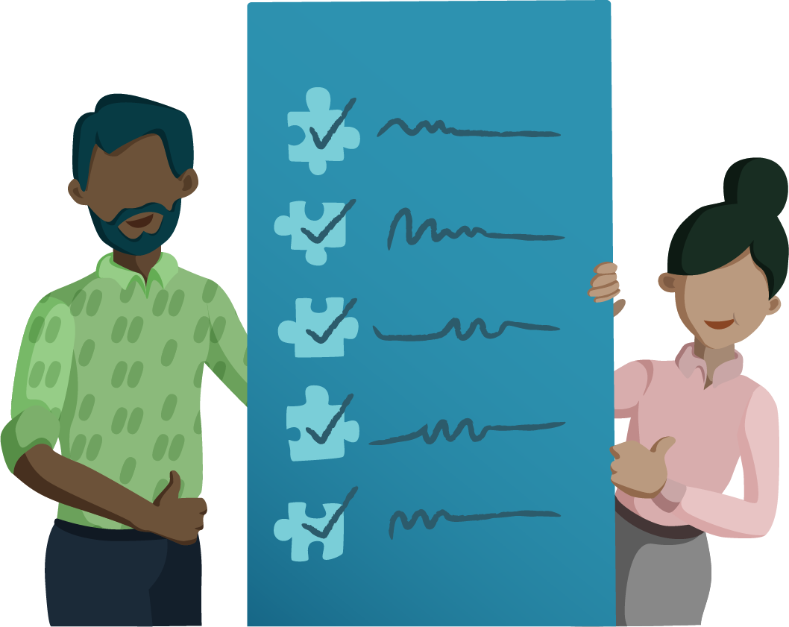
What is the Demand Strategy Builder?
The DSB is a toolkit that will help you to identify the reasons for low immunization and develop innovative solutions to increase vaccine demand.
Get ready to…
Find new solutions to generate demand for vaccination
Better understand caregivers and healthcare workers
Reduce vaccine inequalities
Develop a high-level plan to help you move quickly from strategy to action!
This will be a collaborative and creative process!
WHAT IS THE DSB?

Slide 8
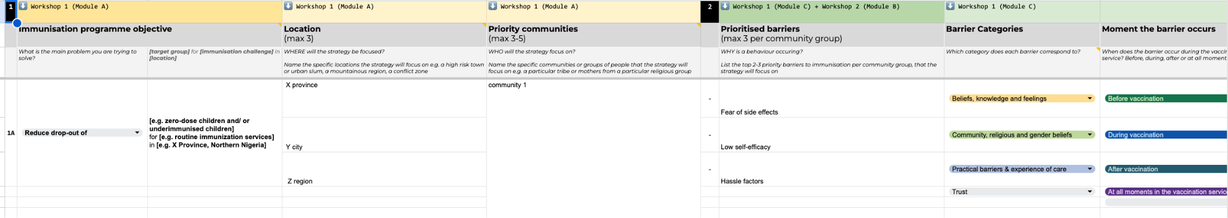
What will you walk away with?
By the end of the DSB process, you should have a demand strategy that is:
Focused
Evidence-based
Human-centred
Solutions-focused
Localised
The DSB will guide you through a process to build out your strategy, step-by-step.
WHAT IS THE DSB?

Slide 9
What will this look like?
THE STRATEGY TEMPLATE WILL INCLUDE THESE COMPONENTS
Throughout the DSB process, you’ll work together to complete:
Your Immunization Programme Objective: The main objective of your Immunization Demand Strategy.
Priority Locations: The areas and regions that your strategy will target.
Priority Communities: The key groups your strategy will support.
Barriers to Immunization: An overview of the key challenges that prevent caregivers from vaccinating their children.
Solutions: Simple and actionable steps to address these challenges.
Implementation Plan:
  Timeline: When each step will take place.
  Budget: The estimated cost for each solution.
  Funding sources: Where the money will come from to fund your solutions.
  Implementers: The people or groups responsible for the work.
  Indicators: Measures to track progress and success.
WHAT IS THE DSB?

Slide 10
Key steps in the process
INSTRUCTIONS - delete before presenting
Explain the overall DSB process and its key moments.
Let participants know the average time it takes to complete the process from start to finish.
Outline how steps can be skipped or more light touch if existing data exists and decisions around priority communities and barriers have been made.
STEP | INITIAL INSIGHTS (2-3 days) | WORKSHOP 1 (2 days) | FIELD RESEARCH (1-2 days) | WORKSHOP 2 (3 days) | FINALISATION (Half day)
Description | Core team analyses data and plans the budget, timeline, and logistics for the DSB process. This step is critical for success. It ensures alignment and ownership of the process, and develops a plan. | Two-day workshop to define focus areas, communities, and barriers to vaccination. | One or two-day field trip to collect qualitative data on immunization barriers and to build empathy. If existing behavioural data is sufficient, this step can be skipped. | Three-day workshop to analyse fieldwork, develop solutions, and create an implementation plan. | Finalise and polish the demand strategy for implementation.
Recommended Participants | Core team (3-5 people) | 25-30 participants. A mix of community leaders, healthcare workers, local government, UNICEF | All workshop participants | All participants. Key decision-makers e.g. Local government (EPI), UNICEF, municipal gov | Core team and key decision-makers
*The full time needed for the DSB is around 10 to 12 days, including workshop facilitation and planning time. The entire process could take up to 3 to 6 months depending on the availability of decision-makers and partners and time for planning.
WHAT IS THE DSB?

Slide 11
DSB Process
INSTRUCTIONS - Delete before presenting
In the next 5 slides, provide some context for each of the key moments or steps in the DSB:
  Objective
  Modules and activities
  Duration
On the final slide, briefly explain the tools in the kit.
STEP 1: Initial Insights
Goal: To plan a well-organised DSB process, and gather data to inform an evidence-based demand strategy and immunization objective.
Key Activities
Build a strong team with leaders skilled in facilitation and logistics to keep everything on track. (Module A)
Review data before the workshops to avoid repeating work and ensure your strategy is based on evidence. (Module B)
Invite the right people to strengthen your strategy with their input, approval, and support. (Module C)
Budget for key costs like venues and stipends. Plan for future funding to avoid gaps during implementation. (Module D)
Plan for workshops with 20+ people. Book venues, send reminders, and handle details to ensure a smooth event. (Module E)
WHAT IS THE DSB?

Slide 12
DSB Process
STEP 2: Workshop 1
Workshop 1 is an opportunity to agree on the key problems we want to solve and to ask ourselves: what do we know, and what do we think we know? Together, we’ll go through an active discovery of who is most at risk of not being vaccinated, and why.
Key Activities
Validate your data from Initial Insights, and confirm your priority areas, communities, and immunization programme objective that your strategy will focus on. (Module A)
Understand your priority communities through a “persona” activity. (Module B)
Map barriers to vaccination through the perspective of caregivers and service providers, and prioritise barriers. (Module C)
Identify gender-related barriers to vaccination. (Module D)
Make a plan to visit the field to validate assumptions and collect data. (Module E)
WHAT IS THE DSB?

Slide 13
DSB Process
STEP 3: Field Insights
You’ll be divided into small teams to go into the field and collect insights from the people you’re trying to support.
Key Activities
Finalise logistics for the field visit, including transport, accommodations, and participant incentives.
Confirm priority communities, participants, and interview locations.
Provide safety guidelines and consent protocols for interviews and recordings.
Equip field teams with essential materials and tools.
Set up communication channels for updates and support.
Monitor field teams and assist with data collection and challenges.
Review and organise data to prepare for analysis in Workshop 2.
WHAT IS THE DSB?

Slide 14
DSB Process
STEP 4: Workshop 2
Now that you’ve collected new insights from the field, reconvene to share the collected data in person, and come up with solutions to solve identified barriers. Then, together, finalise the Demand Strategy.
Key Activities
Participants review data from the field, analyse insights, and validate barriers. (Module A)
Teams share their barriers, get feedback, and update the demand strategy. (Module B)
Participants brainstorm, refine, and prioritise solutions to address the key barriers. (Module C)
Teams make the strategy actionable by developing a timeline, identifying indicators, creating a budget, and assigning roles. (Module D)
WHAT IS THE DSB?

Slide 15
DSB Process
This step is for the core DSB team + key decision-makers
STEP 5: Closing & Post-Workshop
With the finalised demand strategy in hand, this step lets the core team put the finishing touches on the demand strategy and get it ready for implementation!
Key Activities
Streamline the strategy, clean up content, and fill in any gaps—ensuring it’s complete and ready to move forward towards implementation. (Module A)
Convene the key decision-makers to review the strategy, define next steps, and clarify everyone’s roles in bringing it to life. (Module B)
WHAT IS THE DSB?
Notes:
Put the finishing touches on your demand strategy and get ready for implementation!

Slide 16
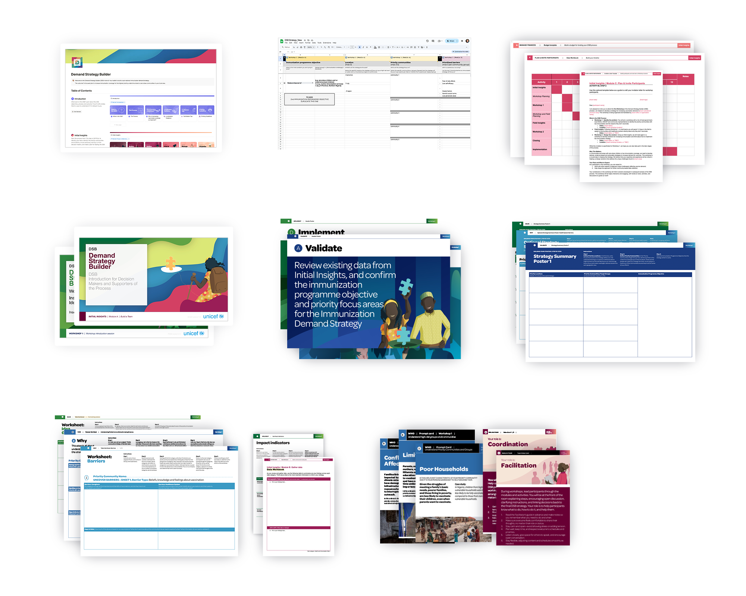
The Toolkit
ONLINE FACILITATOR’S GUIDE
FILLABLE STRATEGY TEMPLATE
TEMPLATES
The DSB includes many rigorous and fun tools to help research, ideate and generate an effective immunization strategy–all organized in a step-by-step process.
PRESENTATIONS
HEADER POSTERS
SUMMARY POSTERS
WORKSHEETS
PROMPT CARDS
WHAT IS THE DSB?

Slide 17
How does this process fit in with an existing
HCD solution
or ideation process?
INSTRUCTIONS - delete before presenting
Optional slide - if there is existing HCD work, you can use these slides to show the additional value the DSB can provide to work alongside existing HCD work.

Slide 18
A HCD solutioning process and the DSB have different strengths and focus
Human Centred Design:
The DSB:
Rapidly ideates with communities and partners to co-create local solutions to specific challenges
Can often focus on activity level interventions
Can focus on innovation, yet be disconnected from a system or an owner
Builds on existing knowledge and on rapidly collected research to identify barriers and challenges
Develops a high-level plan for operationalisation of solutions
Addresses feasibility, funding, and decision-makers’ buy-in to solutions
Connects to an owner that can coordinate and drive the process, and monitor impact
Emphasises localisation throughout the process to identify where and for whom demand generation will deliver the most impact
The DSB works alongside existing HCD projects, incorporating HCD research and solutions into the DSB process to build on, rather than replace, existing work.
HOW DOES THE DSB FIT WITH OTHER TOOLS?

Slide 19
Roles & Responsibilities
INSTRUCTIONS - delete before presenting
In this section, briefly go over the roles and responsibilities of key partners and decision-makers.
Emphasise the important role they play in making sure there’s buy-in for the DSB.

Slide 20
Your Role
INSTRUCTIONS - Delete before presenting
In some contexts, the role of these contributors might be more defined. Feel free to include additional information.
You can also ask people how else they’d like to be involved, and lead a discussion.
In the DSB process, you’ll:
Be an important partner in ensuring buy-in of the strategy at the subnational level
Support in operationalising the strategy, such as providing oversight on budget and funding
Help in ensuring the strategy is in line with current programming and plans at the subnational level
Be critical to making sure the DSB has enough resources, oversight, and advocacy
ROLES & RESPONSIBILITIES

Slide 21
Questions & Next Steps
INSTRUCTIONS - delete before presenting
Allow some time for the group to ask questions.
Share next steps, including information on timeline for the DSB process, and where you’re currently at in the journey.

Slide 22
Next Steps
In the coming weeks, we’ll:
Identify and invite participants to join strategy development workshops
Create a timeline that will outline the entire DSB process
Identify funding sources for the development and implementation of the strategy
Collect and review existing immunization data to inform programme objectives, as well as target areas and communities
Prepare logistics and begin to plan for Workshop 1
NEXT STEPS

Slide 23
Thank you!
The DSB toolkit was developed for UNICEF
in collaboration with Common Thread.
This Training of Trainers was developed by Common Thread.

