Slide 1

DSB
Demand
Strategy
Builder
Workshop 2, Module C
Inspiration Presentation for Idea Generation
Insert presentation details here
WORKSHOP 2 | Idea Generation
ROSA version 2.0

Slide 2

Introduction to ideation

Slide 3
What is Ideation?
Ideation is the creative process where you generate as many ideas and solutions to a problem
as possible.
The goal is to think of new ideas that you haven’t tried before.
We are going to use ideation to think of new ideas to help solve for the prioritised immunization barriers.

Slide 4
Rules of Ideation
The right mindset is important for ideation.
Remember:
Aim for quantity: Come up with as many ideas as possible. Don’t worry if they are good ideas or not.
Try new things: Go beyond the ideas you’ve previously tried and tested.
Don’t fall in love: Learn to let go of ideas to make space for new ones.
Don’t judge others: Say “Yes, and…” to build on other ideas rather than critiquing them.
No bad ideas: All ideas are welcome. Be wild in your thinking.

Slide 5
What is a Solution Idea?
INSTRUCTIONS - delete before presenting
Explain the difference between Solutions and Activities. For the strategy, we will be focusing on solutions.
A solution is a way to solve your immunization barriers. It is the main big idea or approach to address a challenge.
E.g. “Mobile vaccination sites that travel between communities for key events,” or “Incentive scheme, providing community discounts to local businesses.”
A solution is not an activity. An activity is a specific action or task that you need to do to implement the solution. E.g. “Organise a community workshop to understand where to place vaccination sites” or “Develop communication materials including posters to raise awareness of the incentive scheme.” Activities are essentially the steps you need to do during implementation.
While activities are important for detailed implementation plans, for your Immunization Demand Strategy we’ll be thinking of solutions to each of the priority immunization barriers.

Slide 6
Solution vs. Activity Example
THE SOLUTION:
Create a network of local vaccine champions to promote vaccines in the community
EXAMPLE ACTIVITY:
Identify trusted influencers within social networks for immunization information
EXAMPLE ACTIVITY:
Develop and conduct a clear, jargon-free training curriculum for vaccine champions
EXAMPLE ACTIVITY:
Create mechanisms that allow champions to learn from each other’s experiences

Slide 7

Ideation Energiser
INSTRUCTIONS - delete before presenting
Facilitate a game/energiser to bring energy to the room and encourage participants to start thinking of ideas.
Give participants 2 minutes to individually think of as many ideas as possible in response to the question: “What are the different ways we can use a fork?” An example answer could be: “to brush hair,” or “add speakers to it so it becomes a musical fork.”
Individually, think of as many ideas as possible around the prompt: “What are the different ways we can use a fork?”
Write each idea you have on a different post-it.
The more ideas, the better!
⏰ ~ 2 minutes

Slide 8
Solutions and ideas that go beyond communications

Slide 9




Moving beyond traditional communication approaches
INSTRUCTIONS - delete before presenting
Explain how it’s important to think of new solutions that are not just communication campaigns to gain awareness of vaccination (as communication campaigns have limited impact).
When overcoming barriers to immunization, we often rely on solutions that use communications to inform or convey a message to people about vaccination, e.g. telling people about the importance of vaccination.
These communications-based solutions can be through different channels, e.g. TV, posters, radio, or social media, which can be effective because of their extensive reach.
Television
Poster/Banner
Radio
Social Media
However, many communications-based solutions have already been tried and tested, and their impact is limited.

Slide 10
Solutions and ideas that go beyond communications

Slide 11

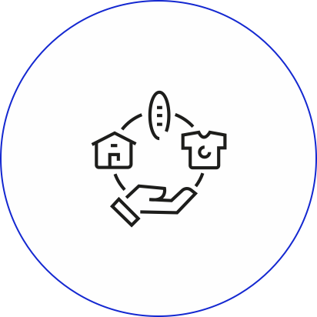

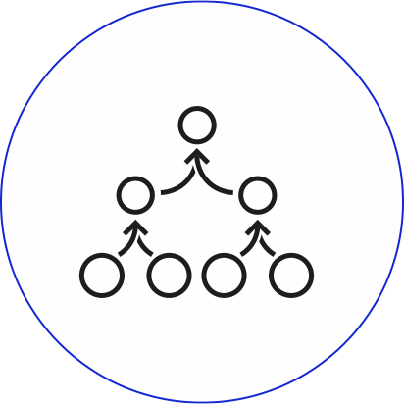
What if…
You could change that?
What if…
We were to shift our focus to new, innovative solutions that go beyond communications-based solutions?

Slide 12
Changing behaviour does not equal education and training
Studies show that education and training alone are often insufficient for driving behaviour change.
They can increase knowledge about immunization, but often don’t motivate people to vaccinate.
While raising awareness is a necessary first step, studies show it leads to behaviour change in less than 20% of cases. (Weitz, et al 2020)
We need other solutions to increase immunization that go beyond communications and awareness-raising. Let’s look at a few examples.
Notes:
(PMC,2022)
(Weitz, et al 2020)

Slide 13
Case study examples

Slide 14
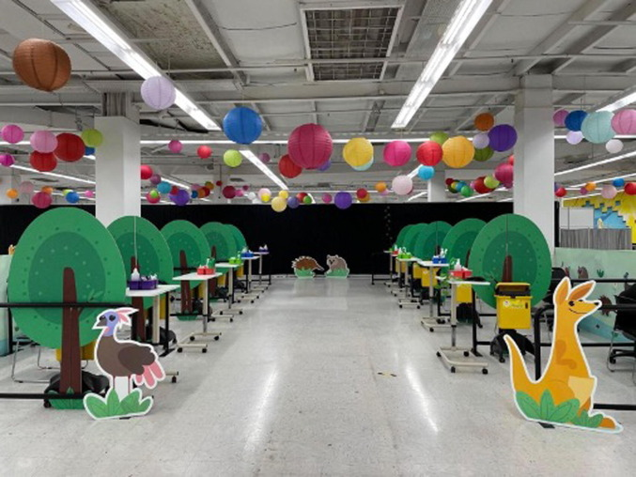
CASE STUDY:
How can we think creatively about SBC solutions?
INSTRUCTIONS - delete before presenting
Present these case study examples of solutions to increase immunization
Focus on the difference between the example solutions. Explain how they are not just communication campaigns to increase awareness of immunization by explaining vaccination benefits. They use different approaches to increase immunization that go beyond communication.
THE PROBLEM
Procedural anxiety and low vaccine uptake in children aged 5 to 11, especially among priority groups.
THE SOLUTION
Redesign of vaccination centres into “Enchanted Forests of Protection” with playful imagery, virtual reality tools, and tailored support for children, including low-sensory spaces and sedation pathways.
BEYOND COMMUNICATION
Goes beyond messaging by redesigning the vaccination experience to reduce anxiety and improve trust.
POTENTIAL IMPACT
94% parental satisfaction and higher vaccine uptake among priority groups. There was also reduced anxiety for children, fostering trust in health systems.
UNICEF & U.S. CDC/UN0666584/Ngakhusi
Notes:
Changing the Clinic Environment to Build Vaccine Trust
https://europepmc.org/article/med/37120401
In Victoria, Australia, a tailored COVID-19 vaccination pathway was designed for children aged 5–11 to address procedural anxiety and increase vaccination uptake. The intervention featured a child-friendly environment, termed the “Enchanted Forest of Protection,” which was implemented in over 58 vaccination hubs across the state. The environment included playful imagery, distraction tools like virtual reality headsets, and trained pediatric staff to reduce anxiety and create a positive experience. Additionally, an online immunization plan was made available to help parents plan the best support for their children. This intervention especially benefited children with needle phobia, developmental needs, or disabilities, as specific provisions, such as low-sensory environments and sedation pathways, were also included.
Results
High parental satisfaction: 94.4% of respondents rated the vaccination experience as very good or excellent.
Increased vaccination coverage: The tailored approach resulted in high vaccine uptake in key priority groups, such as Aboriginal and Torres Strait Islander children and those from culturally and linguistically diverse communities.
Improved emotional experiences: Child-friendly environments and staff reduced anxiety and helped more children feel comfortable getting vaccinated, which likely contributed to higher overall coverage.

Slide 15
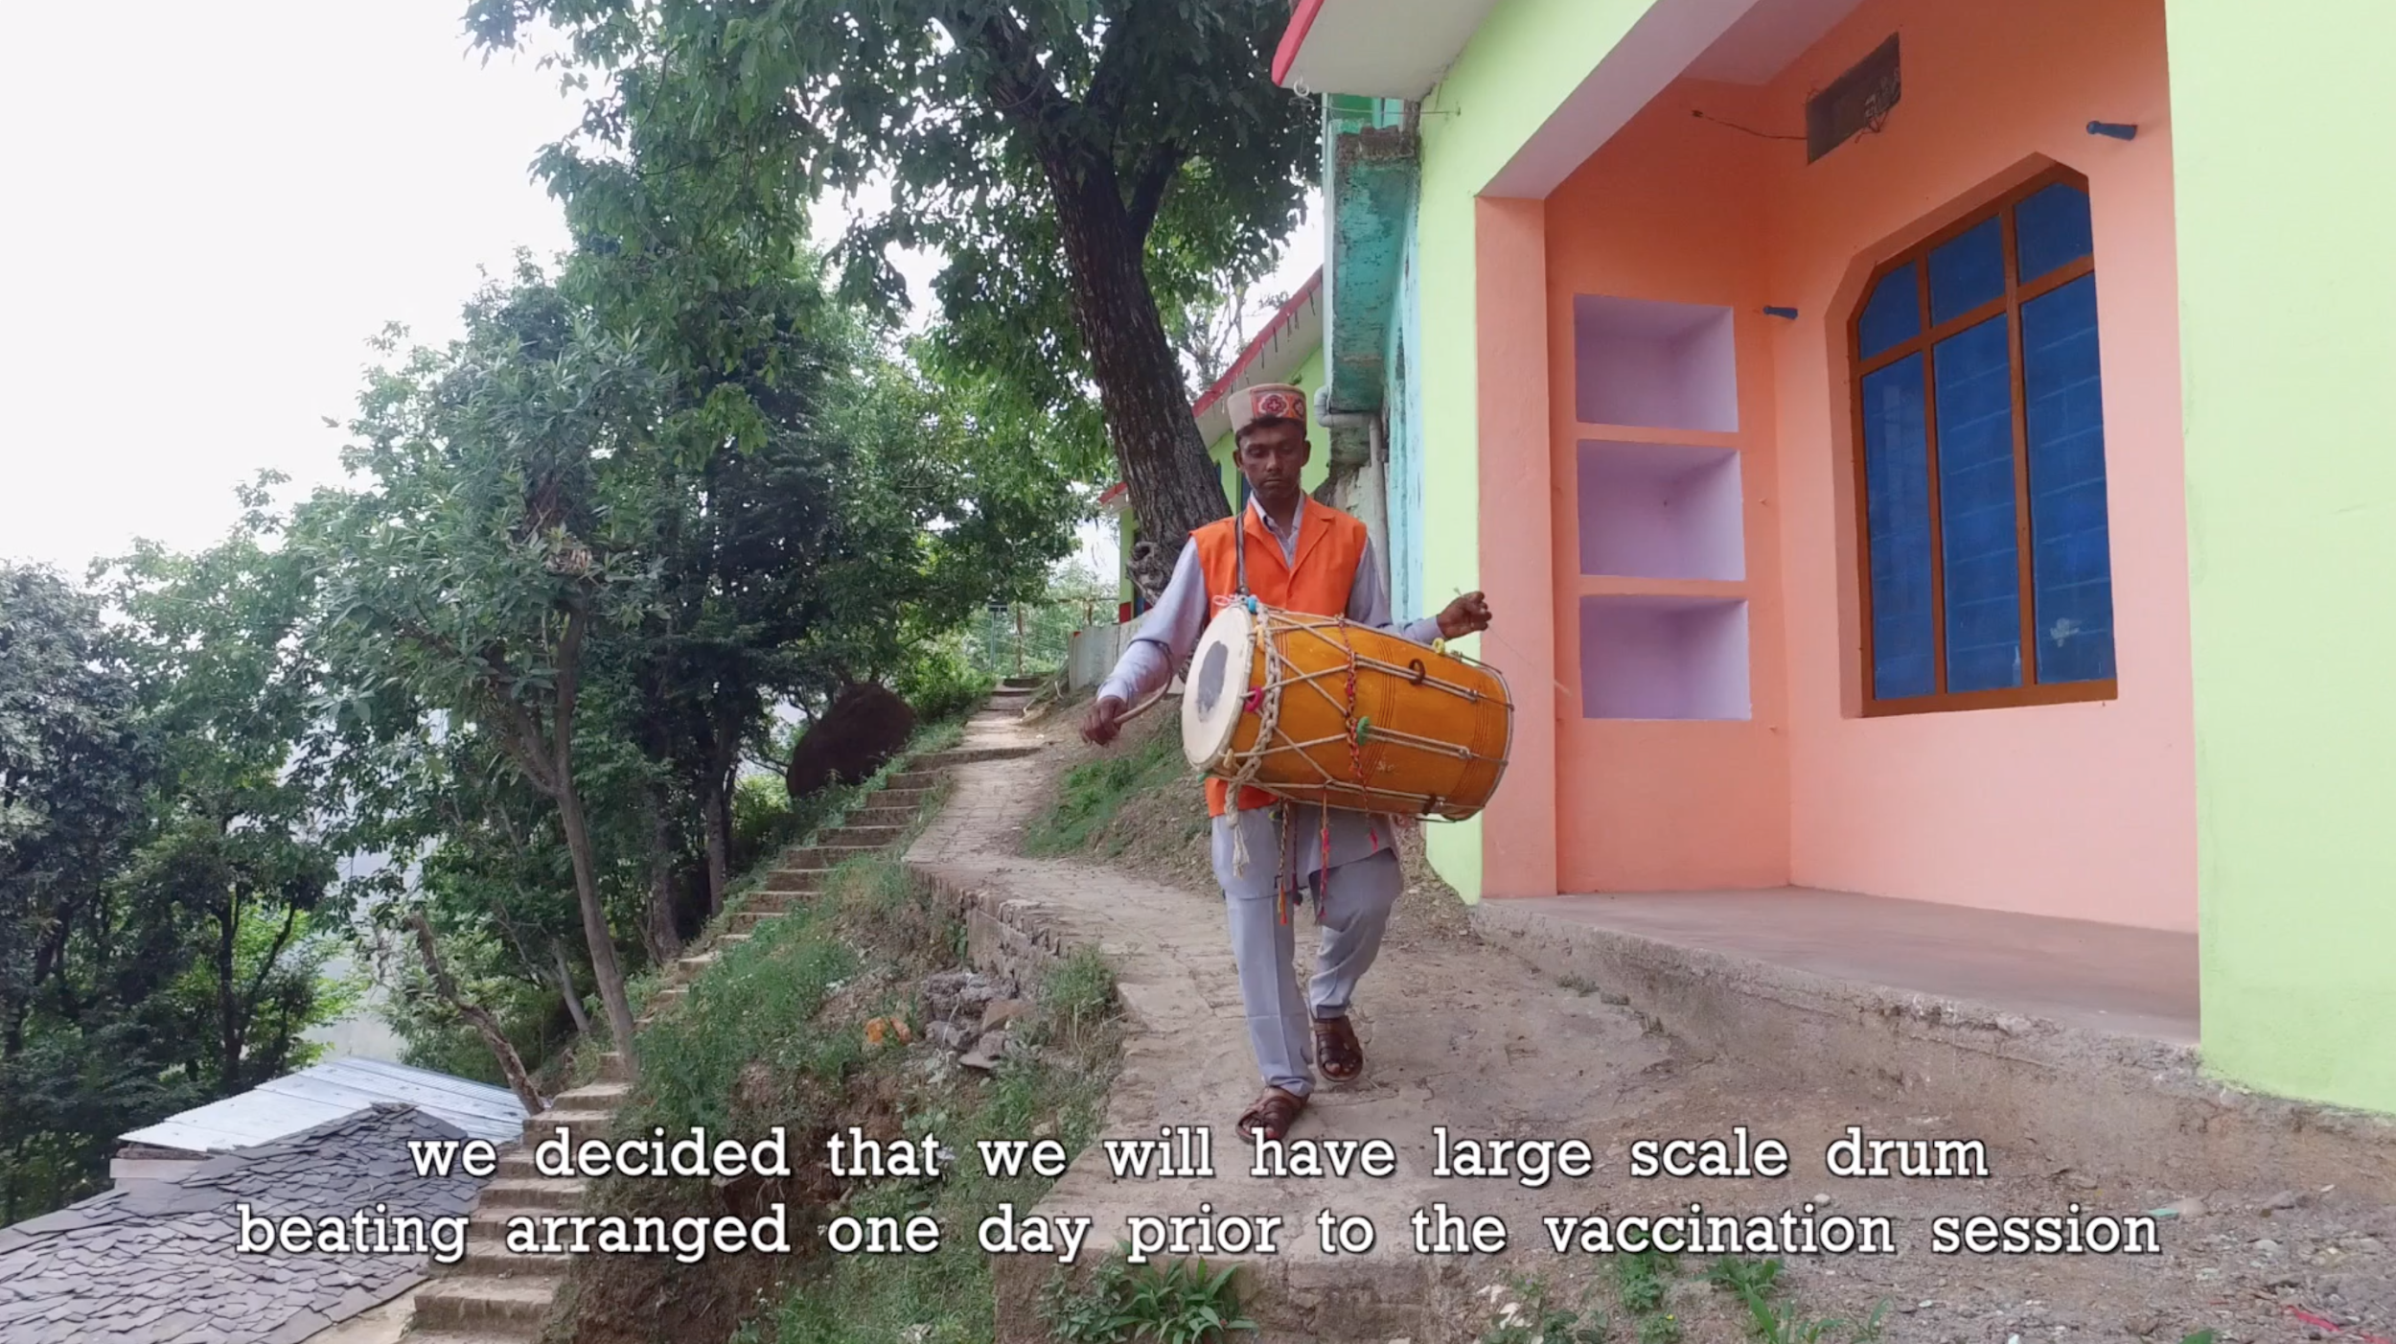
CASE STUDY:
How can we think creatively about SBC solutions?
THE PROBLEM
In the remote village of Sirmaur in India, families often miss vaccination opportunities because they don’t know when vaccinators will be present.
THE SOLUTION
Using a familiar and culturally significant tradition, the sound of drums, to signal the arrival of vaccinators.
BEYOND COMMUNICATION
Leverages a culturally rooted practice to overcome logistical gaps, ensuring even the most remote populations know when vaccination is happening.
POTENTIAL IMPACT
Improved knowledge of when vaccination is happening and increased number of people being vaccinated.
INSTRUCTIONS - delete before presenting
Present these case study examples of solutions to increase immunization
Focus on the difference between the example solutions. Explain how they are not just communication campaigns to increase awareness of immunization by explaining vaccination benefits. They use different approaches to increase immunization that go beyond communication.
UNICEF & U.S. CDC/UN0666584/Ngakhusi
Notes:
Drumming Video – Start to play until 1:47
https://drive.google.com/open?id=1Q5Icep6fE96CpJB6b_DN8RX1fzMKa1kK
DRUMS VIDEO: 6 Start to play until 1:47
In remote areas, getting access to health care and immunization services is a major challenge. Especially for those who live in the most remote spots: the remoteness makes it hard for them to know when the vaccinators will be present and more often than not it makes them miss the opportunity to vaccinate their children on time.
Need a solution that is responsive to this context, and to the needs of this community
Why not use a common tradition, a familiar sound that brings hope and happiness?

Slide 16
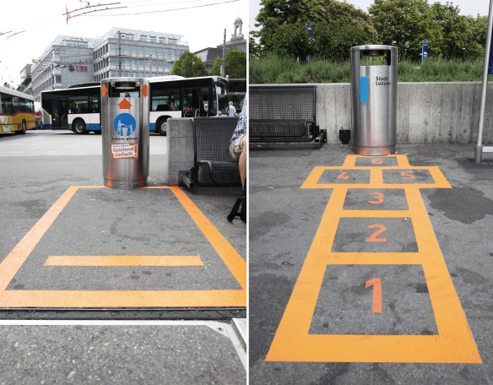
CASE STUDY:
How can we think creatively about SBC solutions?
THE PROBLEM
City cleaning costs are too high, and it's hard to get citizens to help keep the city clean.
THE SOLUTION
Drawing a game (hopscotch—see image on right) on the floor to encourage people to use public bins by making it fun and engaging.
BEYOND COMMUNICATION
This approach doesn’t just raise awareness—it uses games to make a behaviour more appealing.
POTENTIAL IMPACT
Lower cleaning costs, more community participation, and a cleaner city.
INSTRUCTIONS - delete before presenting
Present these case study examples of solutions to increase immunization
Focus on the difference between the example solutions. Explain how they are not just communication campaigns to increase awareness of immunization by explaining vaccination benefits. They use different approaches to increase immunization that go beyond communication.
Notes:
(PMC,2022)
(Weitz, et al 2020)

Slide 17
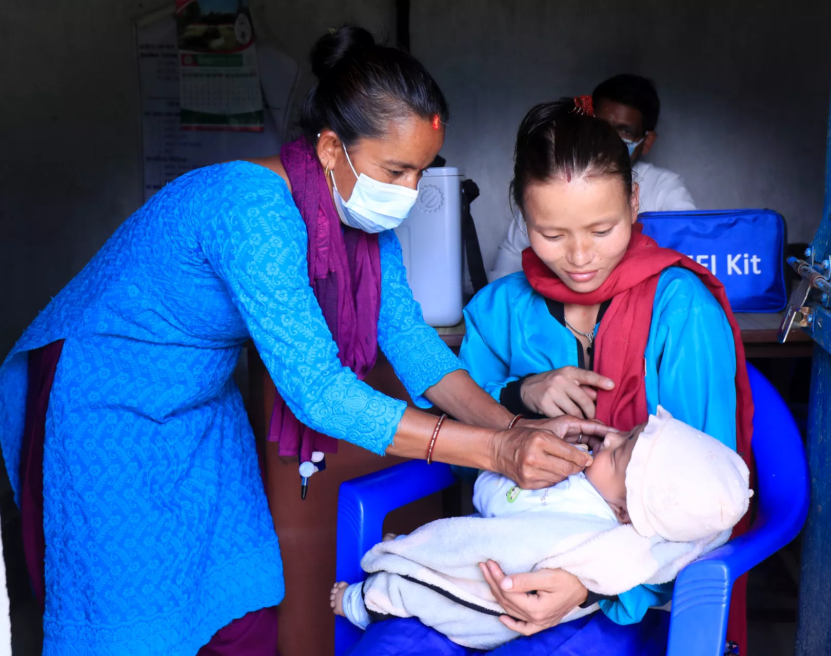
CASE STUDY:
How can we think creatively about SBC solutions?
INSTRUCTIONS - delete before presenting
Present these case study examples of solutions to increase immunization
Focus on the difference between the example solutions. Explain how they are not just communication campaigns to increase awareness of immunization by explaining vaccination benefits. They use different approaches to increase immunization that go beyond communication.
THE PROBLEM
Caregivers often hesitate to vaccinate due to deeply held beliefs, values, and concerns, leading to vaccine delays or refusals.
THE SOLUTION
Using motivational interviewing to guide caregivers in reflecting on their values and concerns, helping them align their decisions with their goals for their children’s health.
BEYOND COMMUNICATION
This approach fosters a non-judgmental dialogue, enabling caregivers to explore their beliefs while building trust and confidence in vaccination.
POTENTIAL IMPACT
Improved caregiver understanding and willingness to vaccinate, leading to higher vaccination rates and stronger trust in healthcare providers.
UNICEF & U.S. CDC/UN0666584/Ngakhusi
Notes:
Boosting Vaccination through Motivational Interviewing
Intervention: Motivational interviewing sessions were used to support parents of infants in understanding the importance of vaccines.
Focus: The sessions addressed vaccine safety, effectiveness, and the importance of routine immunization.
Outcome: Increased vaccination coverage by 3.2% to 7.3% over several months.
Why it worked: The empathic approach helped parents find their own motivation to vaccinate.

Slide 18
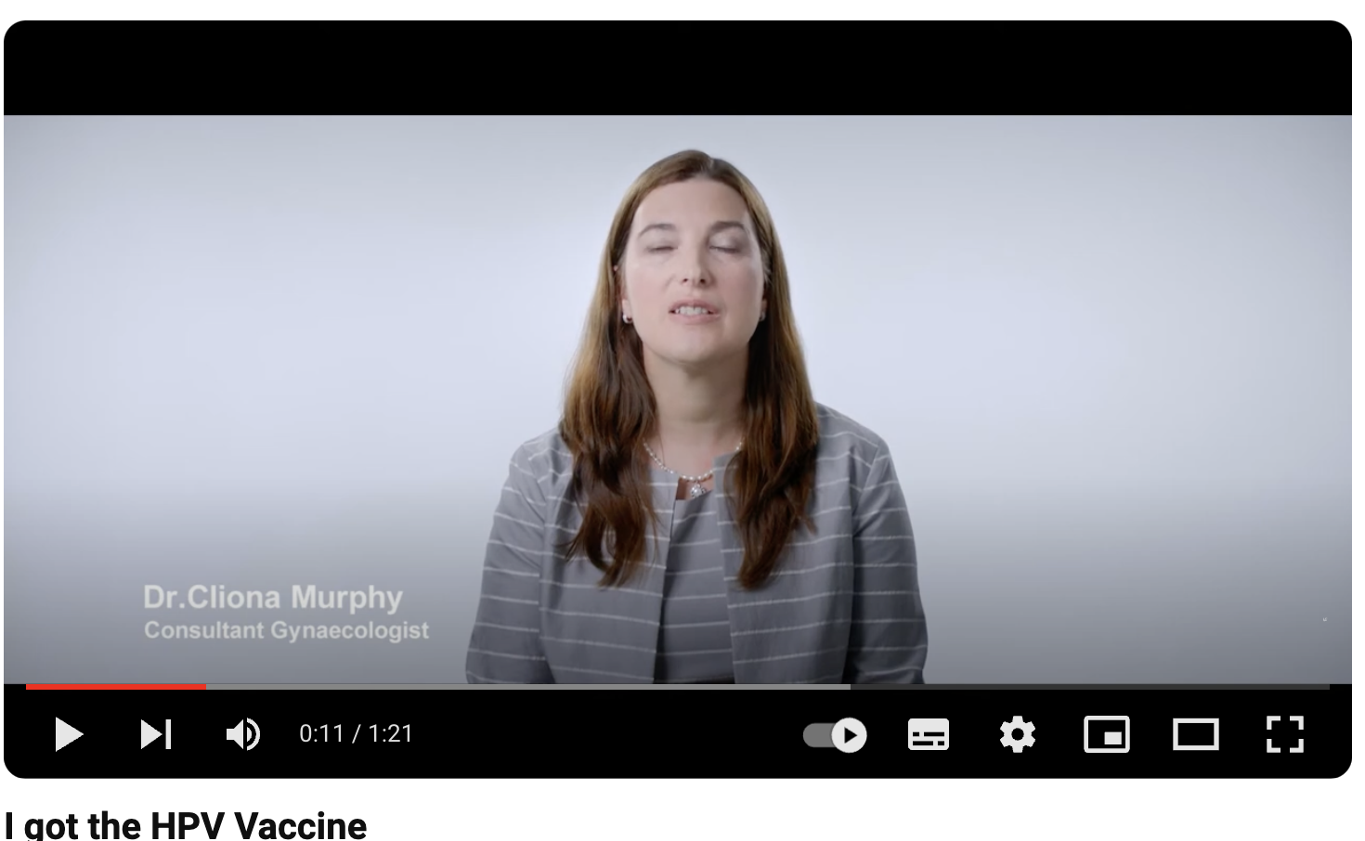
CASE STUDY:
How can we think creatively about SBC solutions?
INSTRUCTIONS - delete before presenting
Present these case study examples of solutions to increase immunization
Focus on the difference between the example solutions. Explain how they are not just communication campaigns to increase awareness of immunization by explaining vaccination benefits. They use different approaches to increase immunization that go beyond communication.
THE PROBLEM
Low HPV vaccine uptake due to lack of awareness and hesitation about its importance.
THE SOLUTION
A campaign showing real people who received the HPV vaccine and emphasising support for vaccination from trusted figures.
BEYOND COMMUNICATION
Goes beyond awareness by leveraging social proof and trusted voices to build confidence and reduce hesitancy around the HPV vaccine.
POTENTIAL IMPACT
Increased vaccine confidence and uptake, particularly among hesitant populations, fostering trust in public health recommendations.
“I got the HPV vaccine”
UNICEF & U.S. CDC/UN0666584/Ngakhusi
Notes:
https://www.youtube.com/watch?v=CwReNjXp-CQ

Slide 19
Ideation: Round 1

Slide 20
Ideation: Round 1
💡
Tip: Generate solutions that are specific and focused on solving a particular barrier.
Think of solutions for each of the priority barriers
In your group, select one of your prioritised immunization barriers.
The facilitator will start a timer for 3 minutes.
Individually, generate as many ideas as possible to solve for that barrier.
Write each idea on a post-it note or separate piece of paper. Remember, one idea per post-it note.
Once the timer ends, stop!
⏰ ~ 3 minutes per barrier.
Repeat the exercise until each group has thought of solutions for each of their prioritised barriers.

Slide 21
Ideation: Round 2

Slide 22
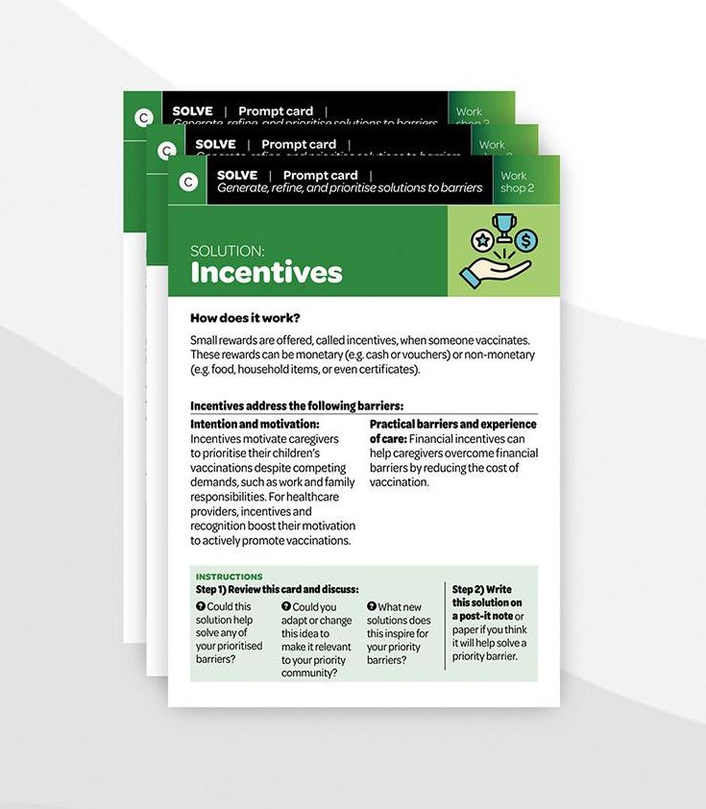
Idea Inspiration
Review the “Prompt Cards: Solve” on your table. These cards show successful immunization interventions from around the world.
Use these as inspiration to think of new solution ideas for your prioritised barriers, or to improve any existing ideas.

Slide 23
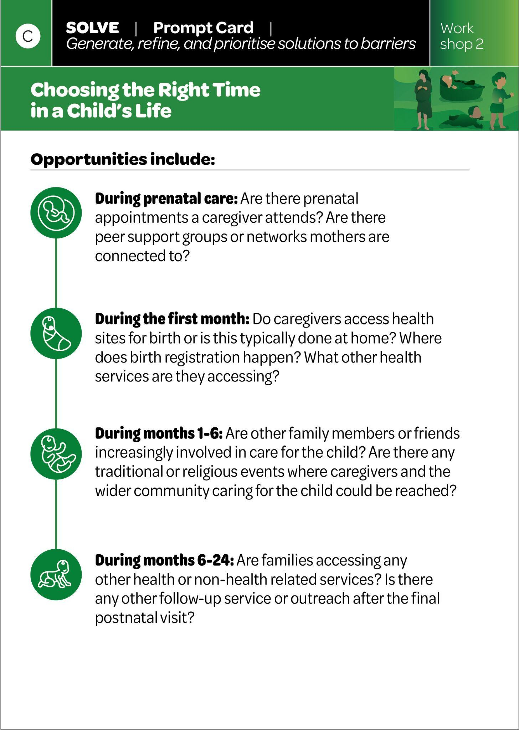
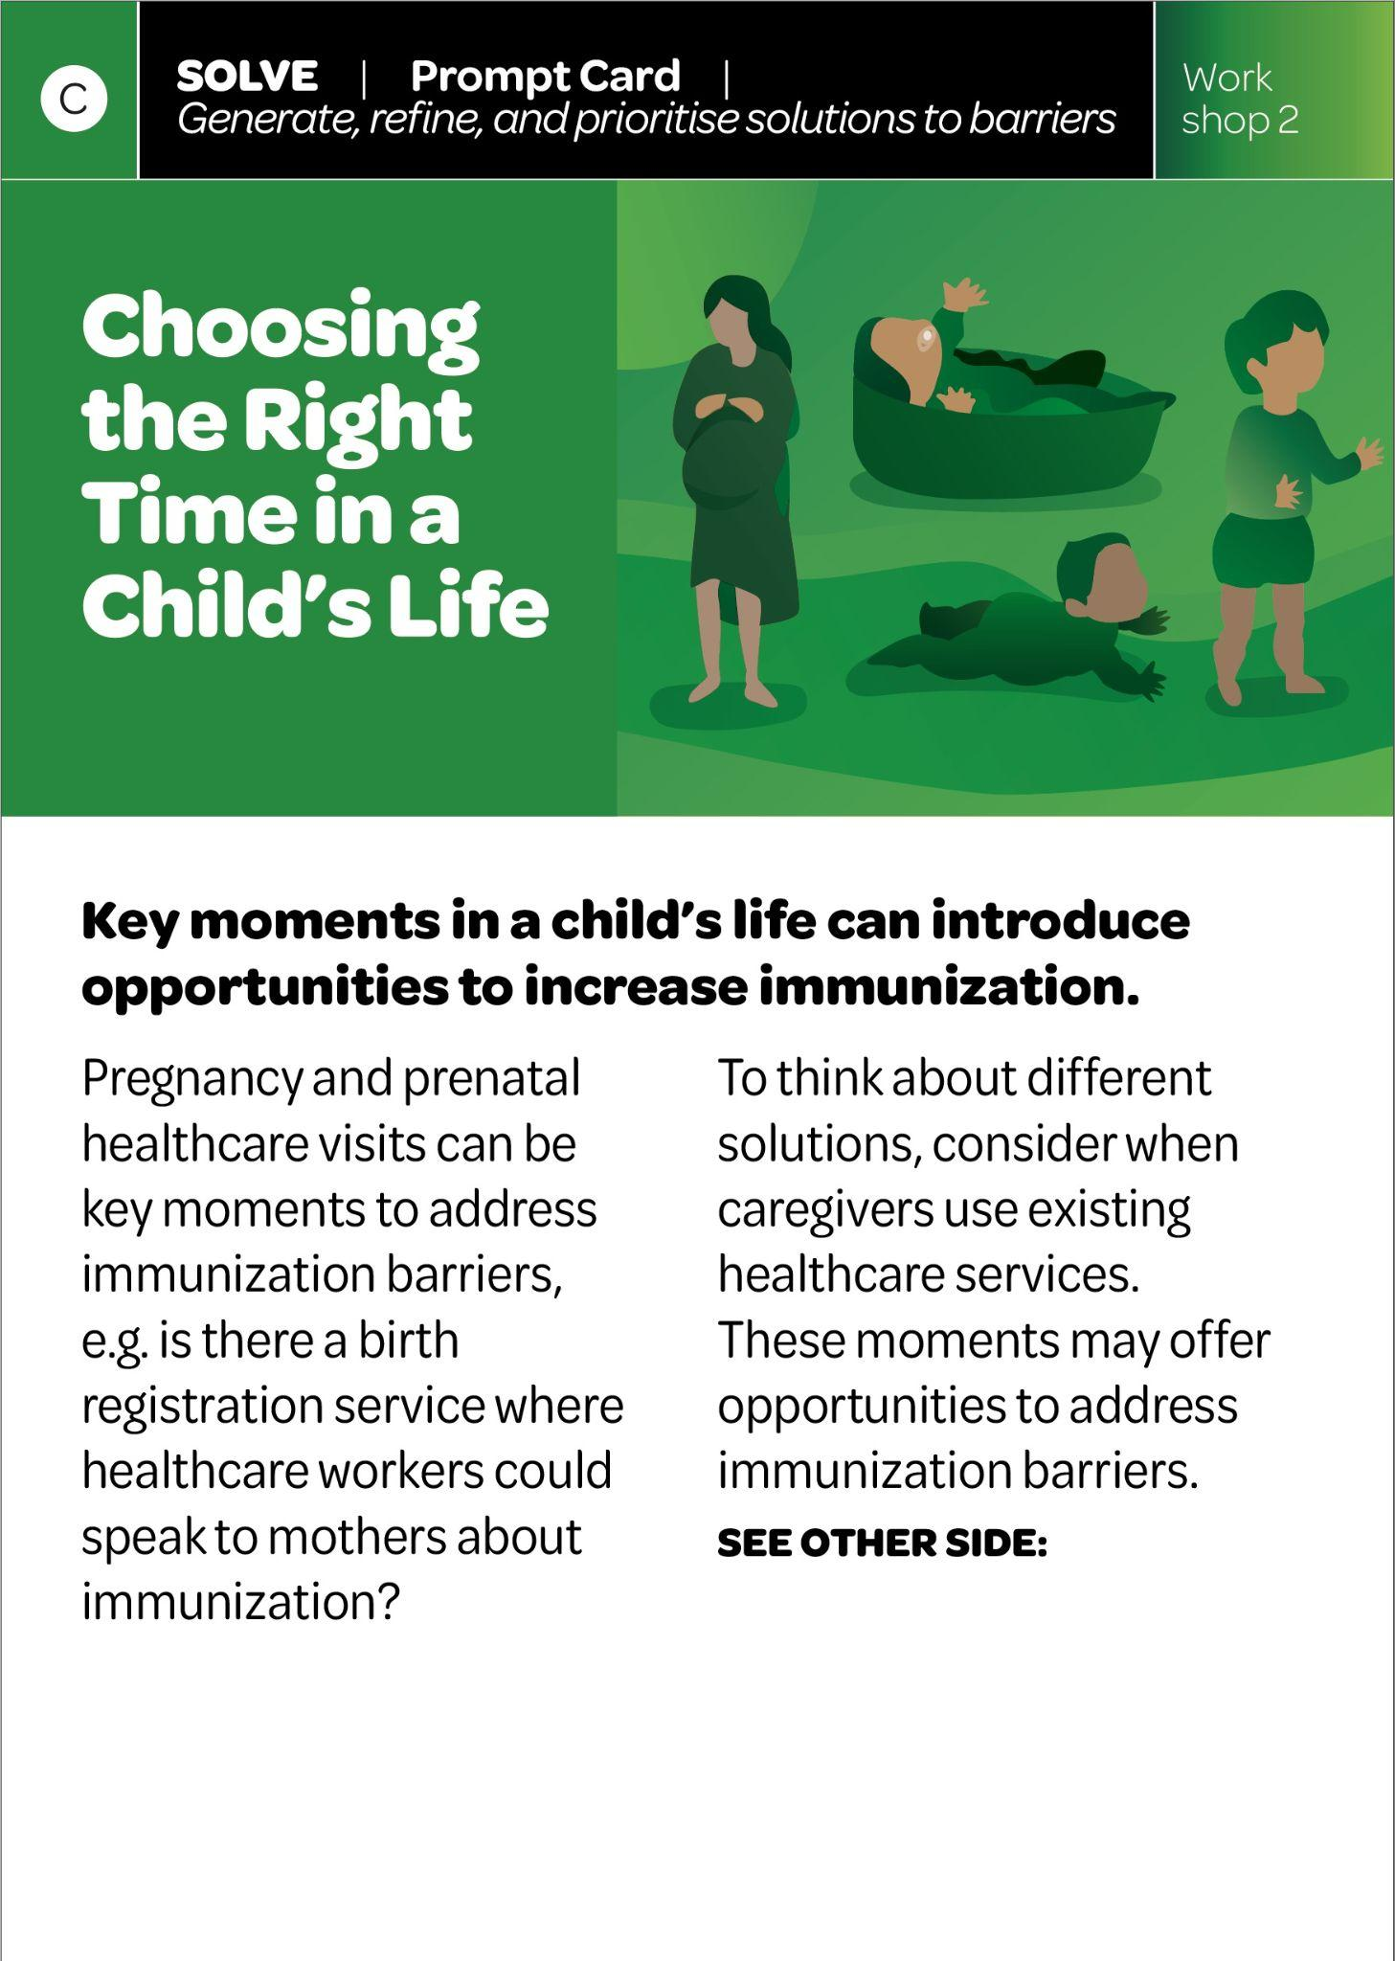
When in a child’s life your solutions can target
As a child grows older, they access different health services and have different interactions with people outside of their family. It’s important to think about moments or times in a child’s life that could be opportunity areas for your solutions.
Think about what potential touchpoints there are for accessing children and caregivers:
  Prenatal period
  First month of baby’s birth
  1 to 6 months
  6 to 24 months

Slide 24
Ideation: Round 2
Think of newer solutions using inspiration from around the world
As a group, read each of the Solve Cards. Discuss:
  Could this solution or idea help solve any of our prioritised immunization barriers?
  What parts of this idea could we adapt or change?
  What new ideas does this inspire?
Write any new or enhanced solutions on post-it notes or blank paper.
Remember: Each card identifies which immunization barrier categories it is relevant to, e.g. Trust. Use this to match the card to your priority immunization barriers.
⏰ ~30 minutes

Slide 25
Discuss ideas and choose your favourites
In your groups, discuss your ideas for each of the prioritised barriers.
Think about:
  Which ideas are your favourite?
  Which ideas are new and haven’t been tried before?
  Are any of your ideas similar to other ideas in your group? Combine these ideas to make one idea.
Write, or move the post-it notes, of your favourite ideas for each barrier on the “Table Worksheet: Solution Ideas.”
Ensure each idea aligns with the relevant barrier it will solve.
⏰ ~ 20 minutes

